Slide 1



The Power of Data Science
From predicting consumer trends to curing diseases, data science has the potential to change countless aspects of our lives. Discover the skills, tools, and techniques that make this possible.
K
by KUPPIREDDYGARI VIJAY KUMAR REDDY

Slide 2

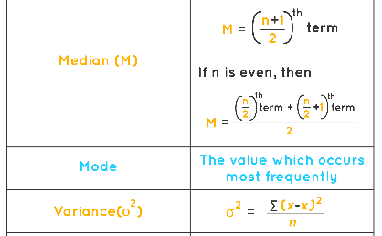
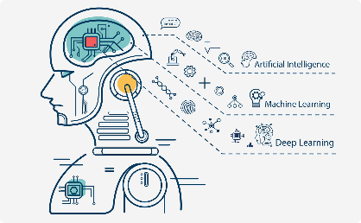
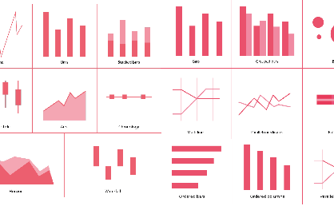
Introduction to Data Science
Data Collection
Statistics
Machine Learning
Data Visualization
Learn how to collect data from various sources and transform it into a meaningful format.
Understand how to use statistics to make sense of your data and draw meaningful insights.
Explore the power of machine learning algorithms to automatically learn patterns in your data and make predictions.
Learn how to create compelling visualizations that communicate your findings effectively to stakeholders.

Slide 3
Key Skills for Data Science
Critical Thinking
Communication
A data scientist needs to be able to think logically and creatively to analyze complex data and derive insights.
The ability to clearly communicate complex ideas to both technical and non-technical audiences is essential for success in data science.
Programming
Domain Knowledge
Proficiency in programming languages such as Python and R is key to working with data, building models, and automating processes.
Having a deep understanding of the domain you're working in can help you ask the right questions and interpret the results of your analysis.

Slide 4
Tools and Techniques Used in Data Science
Exploratory Data Analysis
Understand how to use statistical techniques and visualization tools to explore your data and uncover hidden patterns.
1
2
3
Data Cleaning
Statistical Modelling
Learn how to identify and handle missing data, outliers, and inconsistencies to ensure accuracy in your analysis.
Use regression, clustering, and other statistical models to understand relationships in your data and make predictions.

Slide 5
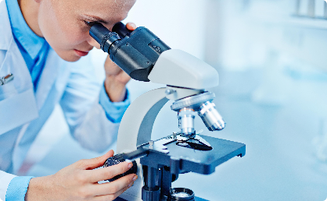
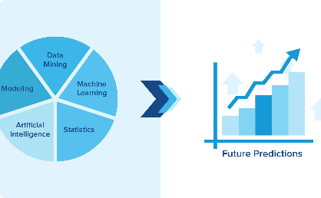


Real-World Data Science Applications
Medical Research
Predictive Analytics
Autonomous Vehicles
Climate Science
Data science is being used to develop new treatments and cures for diseases, as well as improve patient outcomes.
Businesses use data science to forecast demand, manage inventory, personalize marketing, and more.
Self-driving cars rely on data science algorithms to analyze sensor data and make real-time driving decisions.
Data science is being used to model and predict the impact of climate change, and to help mitigate its effects.

Slide 6

Challenges Faced in Data Science
1
Data Quality
2
Data Security
Poor quality data can lead to inaccurate analysis and flawed results.
The increasing amount of data being collected raises concerns about privacy and security.
3
Ethics
Decisions made using data can impact individuals and society, highlighting the importance of ethical considerations in data science.

Slide 7
The Future of Data Science
More Automation
Bigger Data
New Fields
As data science becomes more mainstream, automated tools and platforms will make it easier for non-experts to use.
The amount of data being generated is only expected to increase, leading to new challenges and opportunities in data science.
Data science is already being applied to fields such as sports, politics, and entertainment, and new applications will continue to emerge.

Slide 8



Conclusion and Call to Action
Learn how to become a data science expert and make a difference in the world with our online courses!

